Slide 1
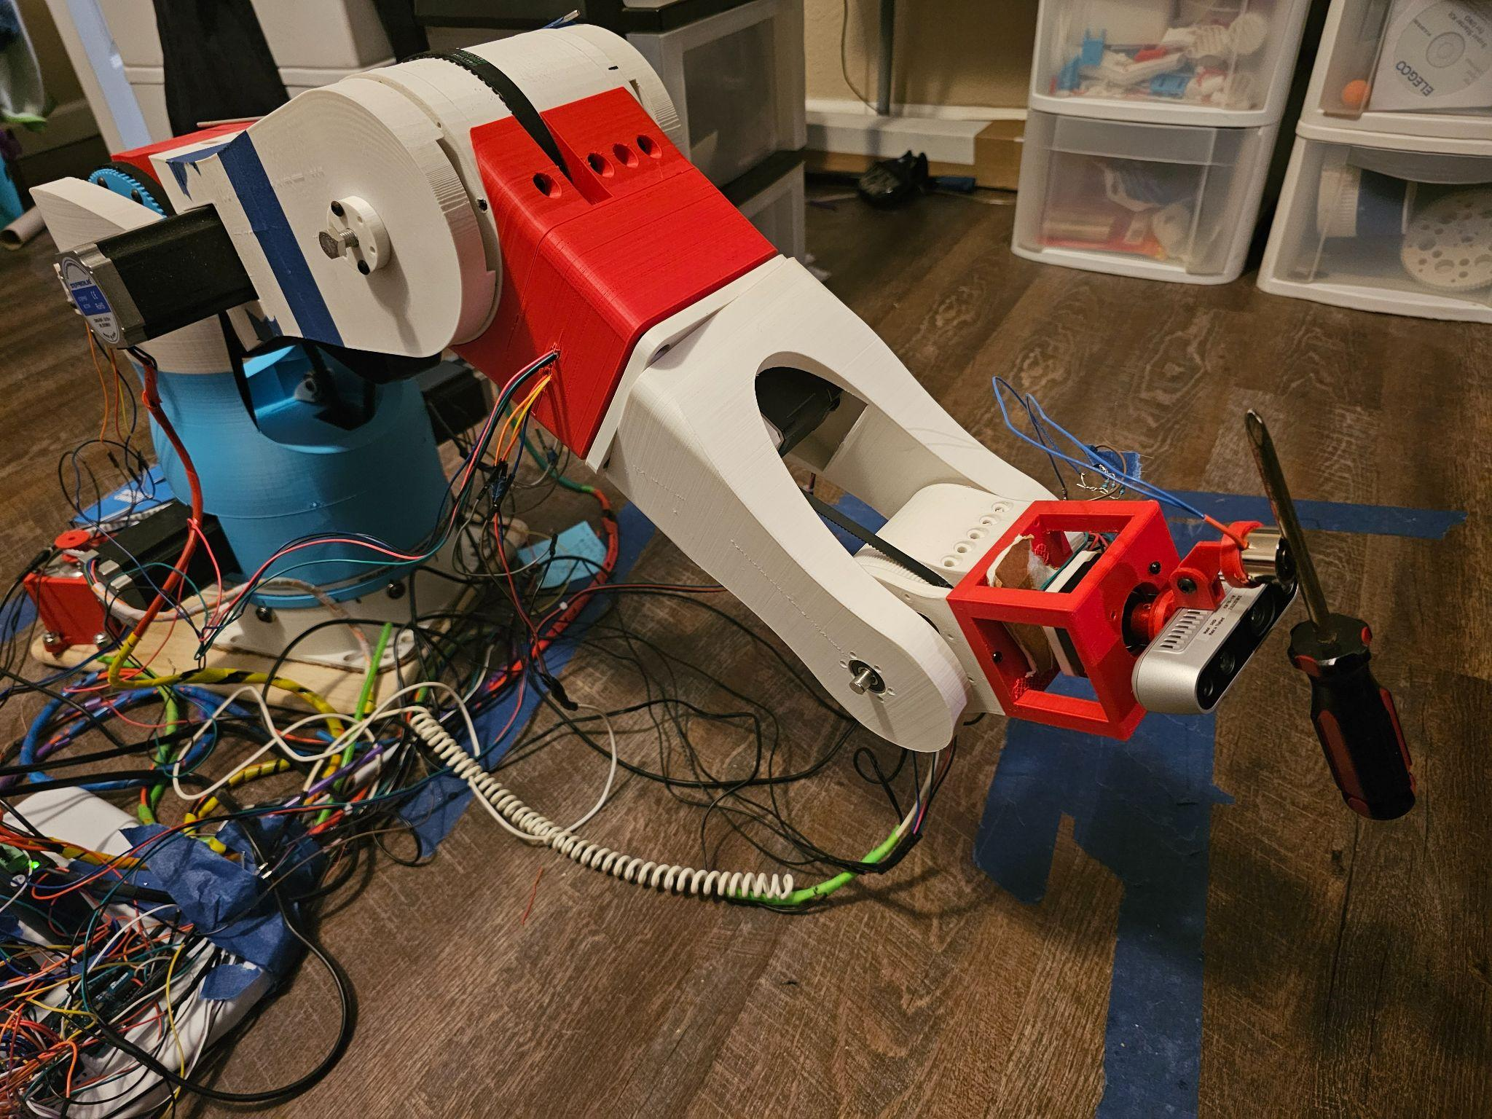
Name of Project: Description of Project (Insert Image of Project Behind Translucent Black Rectangle)
Problem/Question
Programming
Engineering Goal
Design Constraints/Variables
Background
Research
Materials/Cost breakdown
Data Collection Procedure/ Testing
Design
Mechanical
Analysis 1
Data Analysis
Analysis 2
Electrical
Coding
Analysis 3
Analysis 5
Mechanical Assembly/Wiring
Analysis 4
Upgradable encoder mounts
Conclusion
Work Cited

